Slide 1
COMPREHENSIVE
CAMPAIGN PLAN
By: The Virginia Tallent Campaign Group

Slide 2
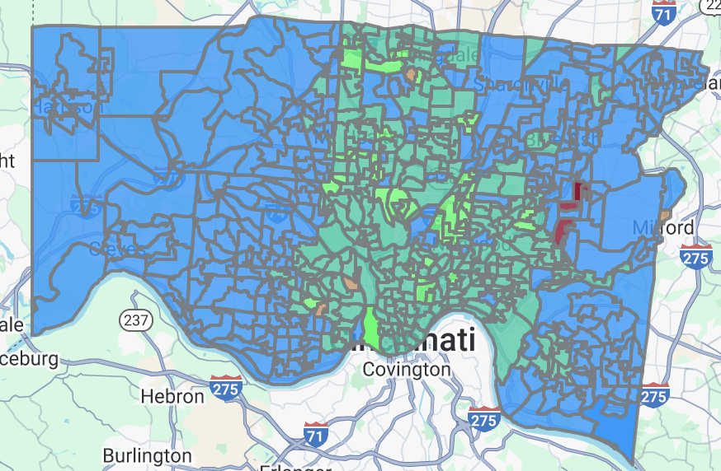
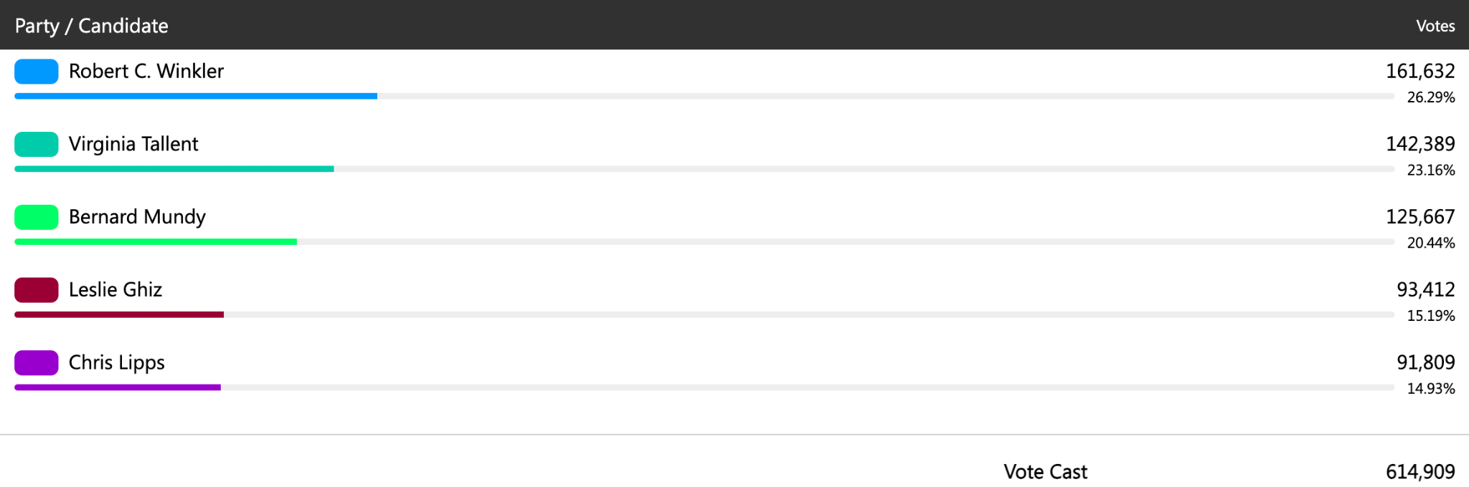
Election Results
Hamilton County Board of Elections
Notes:
Data Science

Slide 3
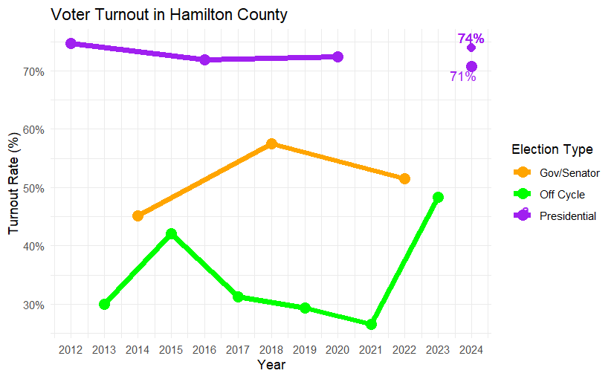
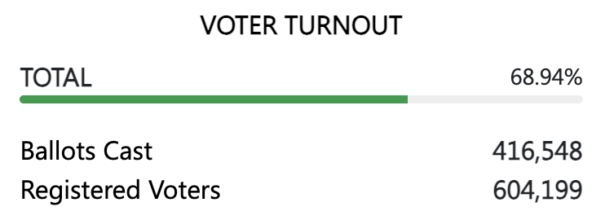
Turnout
Predicted a turnout within the range of 71%-74% for this presidential election.
We came to this conclusion with the aid of the presidential elections in 2012 with a turnout percentage of 74.77%
Notes:
Data Science

Slide 4
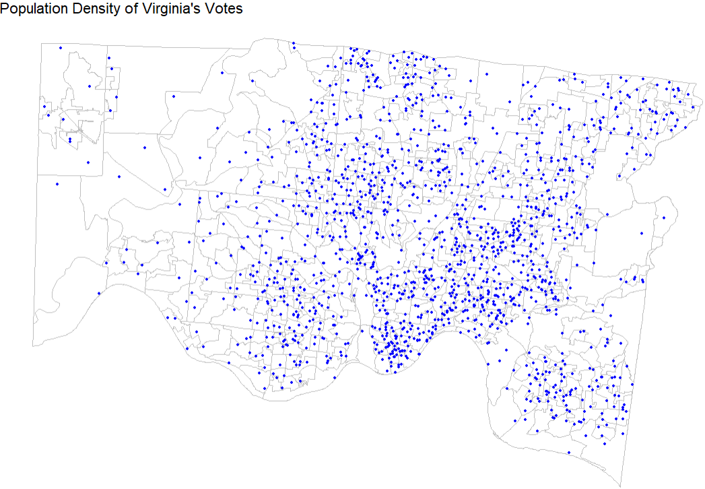
How did our Prediction Fare?
Like we predicted:
Democrat base is primarily the metropolitan area of Cincinnati
Virginia had 142389 total votes
A lower turnout directly impacted this base
Each point represents 100 votes
Notes:
Data Science

Slide 5
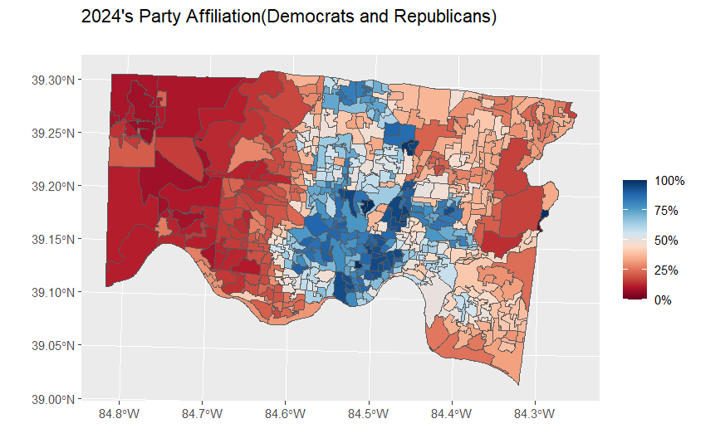
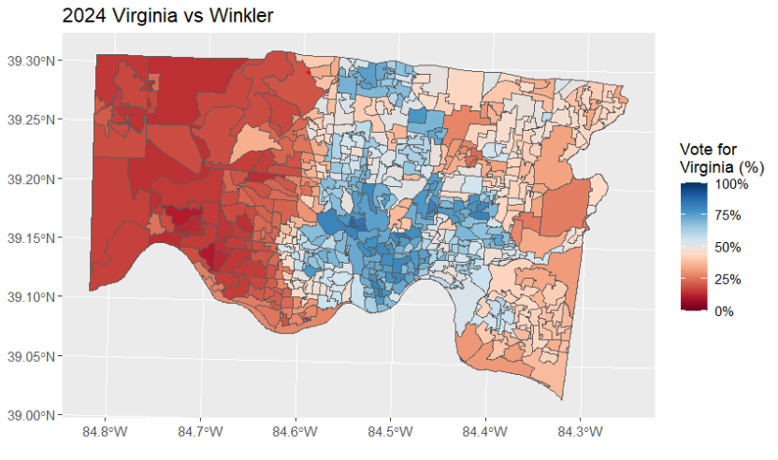
How did the Turnout affect Virginia’s Base?
Quite the difference between predicted and actual
Factor 1: Low Turnout of Democrat Voters
Factor 2: Drop Off
Predicted
Actual
Notes:
Data Science

Slide 6
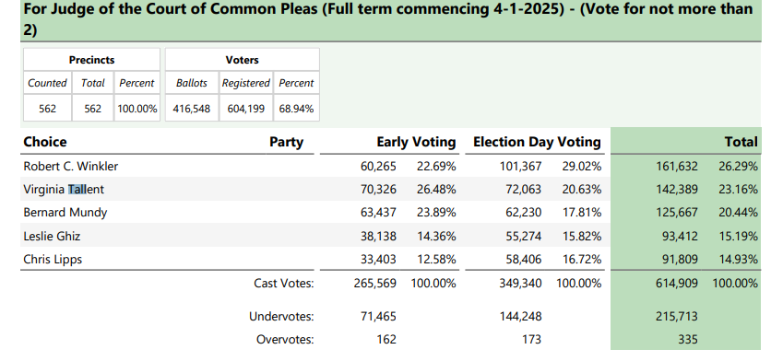
Drop off
In 2012(the last presidential election year with a race for our office) the Drop off was 31.3%
However, this year saw a massive decrease in Drop-Off of 22.1%
Math:Total votes cast for president:410,085
Individual votes:319,196
1-319195/410,085=22.1%

Slide 7
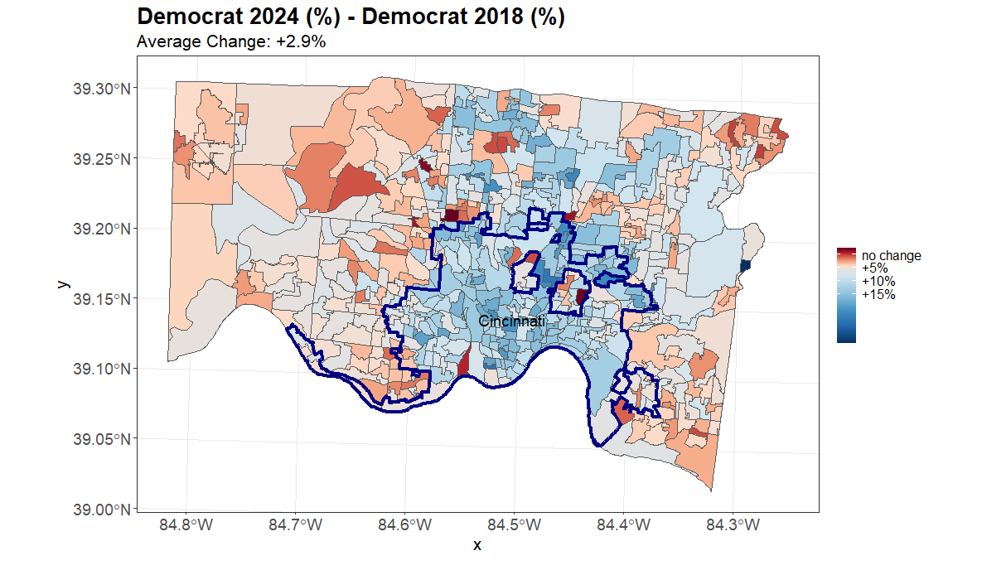
Political Affiliation Shift from 2018 to 2024
(In favor of Democrats)
Max: +29.3%
Min: -10.3%
Avg: +2.9%
Notes:
Data Science

Slide 8
How did the Support of Democrats change from 2018 to 2024
Overall 43% of Democratic votes came from cincinnati in 2024
43% increase in votes from 2018 (34,993 Votes)
for 2024: 44% of votes cast were Democratic and 41% were Republican
for 2018: 44% of votes cast were Democratic and 56% were Republican
Republicans lost 36,070 votes and Democrats gained 84,758
This means that Overall the support for the Democrats in the Court of Common Pleas has significantly increased from 2024.
Notes:
Data Science

Slide 9
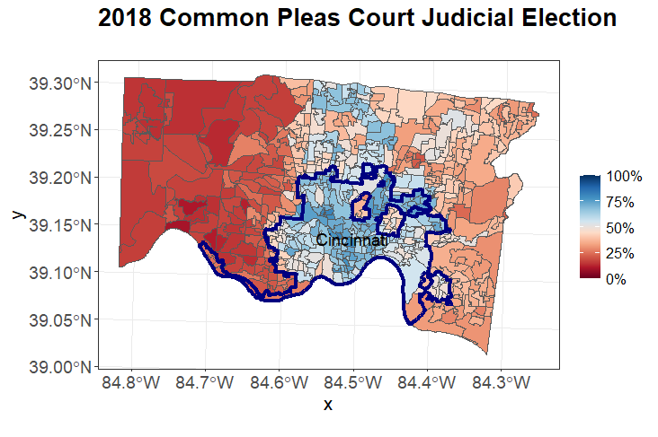
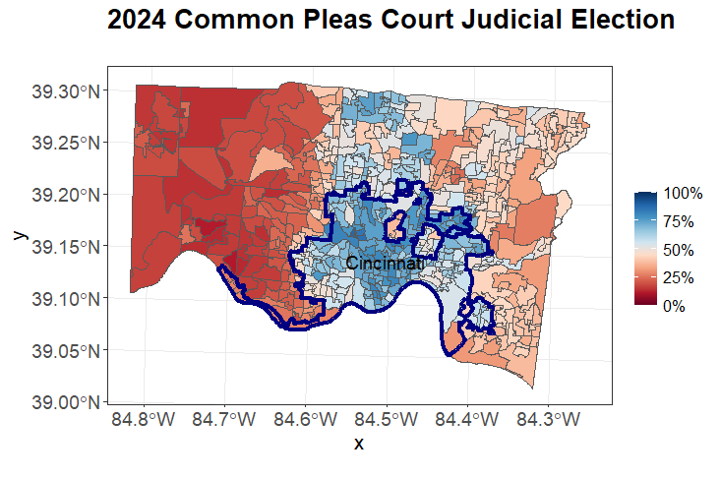
2018 Results vs 2024
Look Extremely Similar
Difference in the Results is because of the changed support of Democrats
Notes:
Data Science

Slide 10
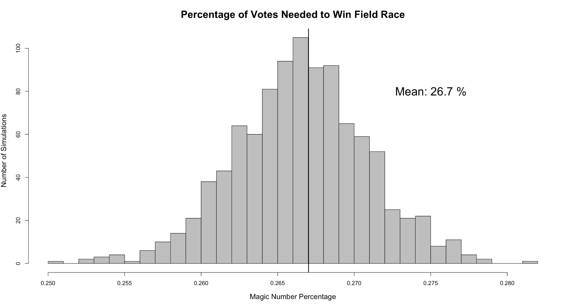
Magic Number
Initial Projections:
448,859 expected ballots
596,623 total votes
119,823 votes for magic number
Final Results:
416,584 ballots
614,909 total votes
125,668 votes for magic number
Notes:
Data Science

Slide 11
Magic Number
What went Wrong?
Lower turnout (particularly affecting democrats)
Abnormal independent candidate
Official Magic Number:
20.45%
125,668 votes
Notes:
Data Science

Slide 12
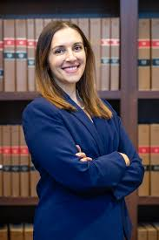
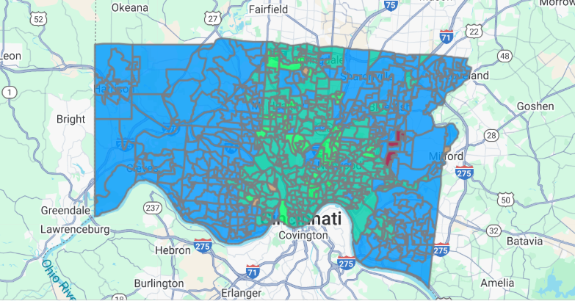
-Some Base Precincts defied expectations
-In particular, areas in Green Township
(Mid-West Hamilton)
-Overall, the county trended more Republican across the board in all races

Slide 13

What would we do differently?
Outreach strategy
Larger social media presence
Presence at more events
Expenses
Gifts to Restricted fund (D. Hamilton County)
Printing & Mailing
Fundraising
Send even more thank you’s
Budgeting
Spend more on Digital Advertising
Invest in Road Signs
Show off endorsements more!

Slide 14

Final GOTV Efforts by the Tallent Campaign
-Posted to her Instagram and Facebook, with a final message to voters about her platform
-Volunteers at the board of elections
-Urging early voters to vote down-ballot
-Calling members of the democratic base may increase win margin
-Lipps for Judge campaign

Slide 15
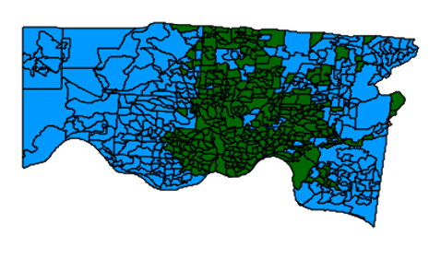
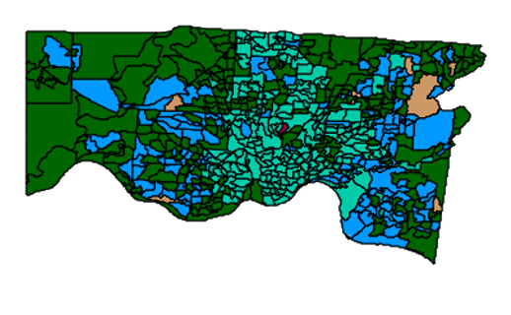
Swing Districts/ Precincts Evaluation

Slide 16
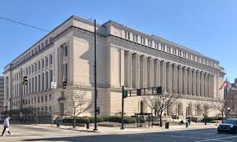
QUESTIONS?

